Slide 1
Important Notes
Slides contain some function codes to get you familiar with the library functions. You yourself should complete them to compile
According to course syllabus, some items are labeled as “Only”. These items won’t be
implemented on the board (only a brief introduction).
3. According to course syllabus, at the end of some sessions, a topic is described briefly.
Then in the next session, we implement it on the board. It makes the students get familiar with the topic step by step. Also this method make the syllabus so
flexible (for better time management).
4. According to course syllabus, some items are labeled as “Optional”. (Webpage link is available for curious students!) .

Slide 2

Why Arduino ?
Open source hardware and software (Arduino IDE).
Easy-to-use hardware and IDE.
Easy tool for prototyping.
Inexpensive.
Cross-platform.
Uploading AVR code directly.

Slide 3
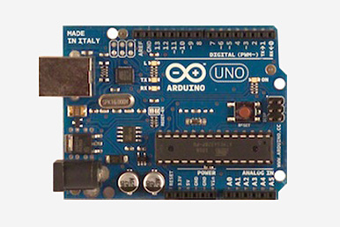
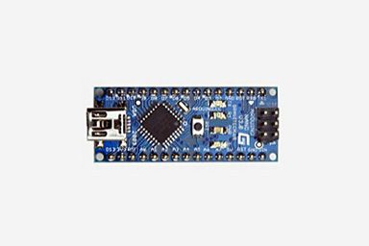
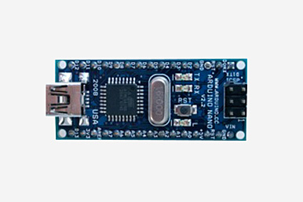
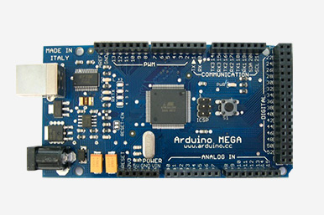
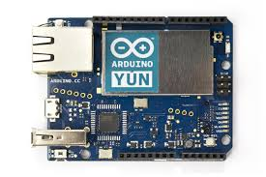
Common Arduino boards
Uno
Nano v3
Nano v2
Mega
Yun

Slide 4
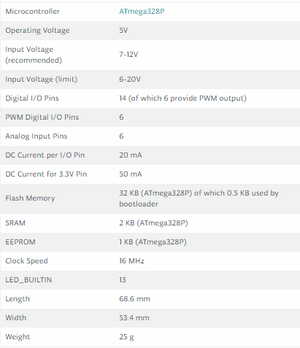
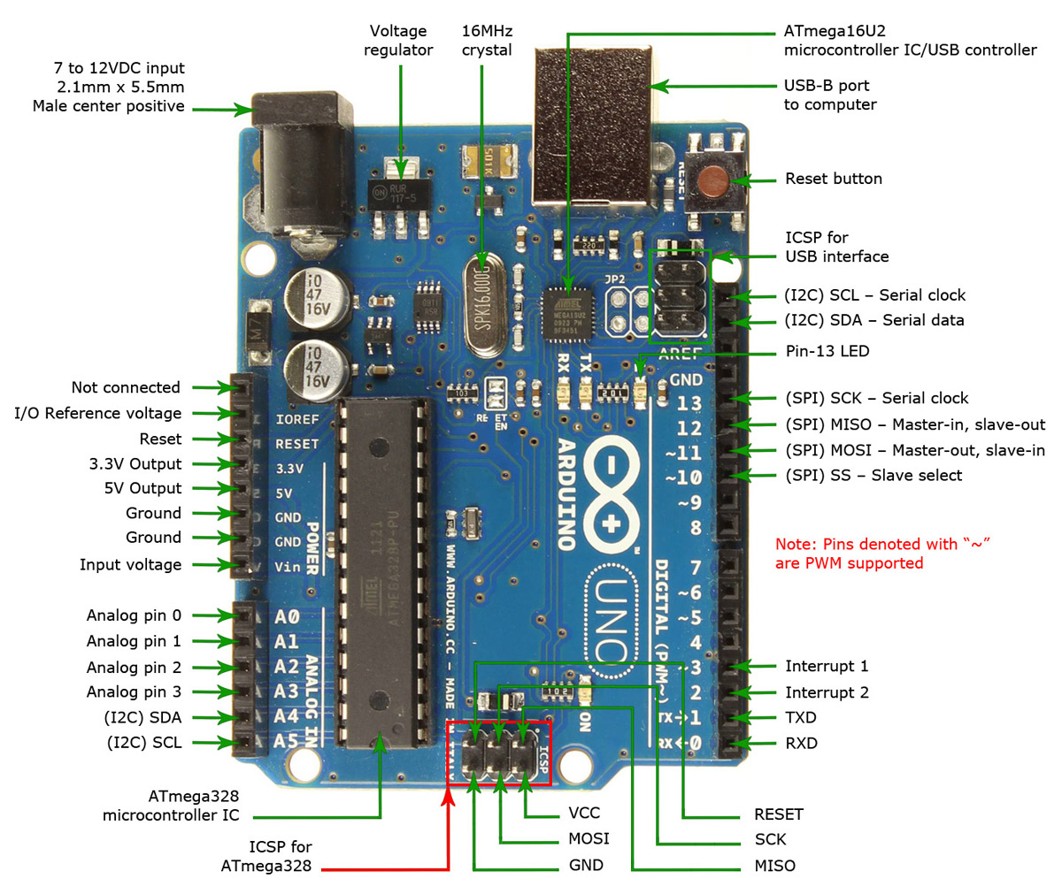
Arduino UNO

Slide 5
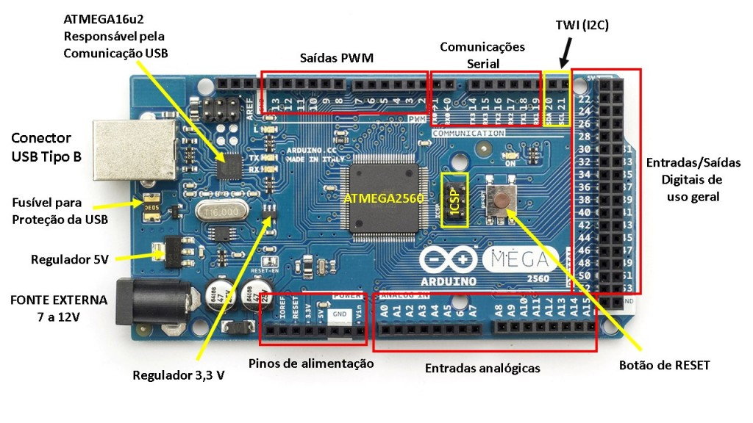
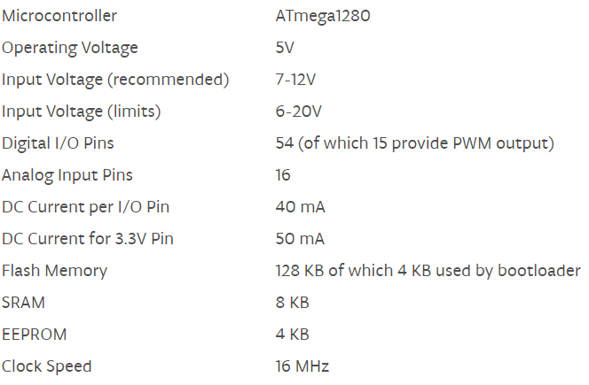
Arduino Mega

Slide 6
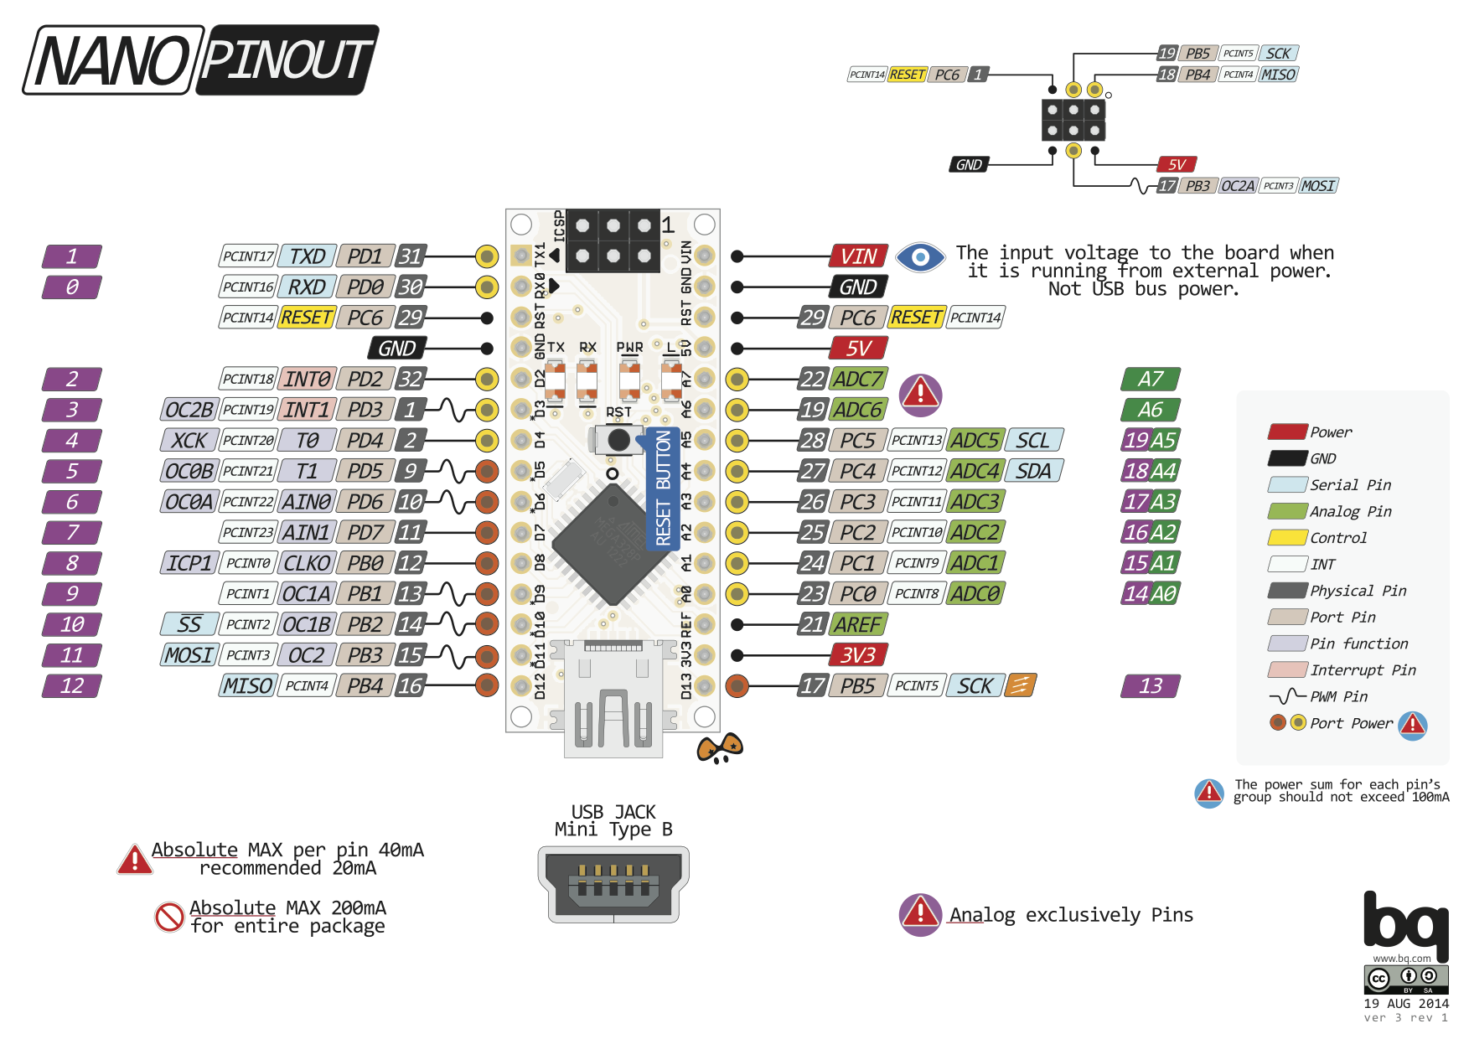
Arduino nano3

Slide 7
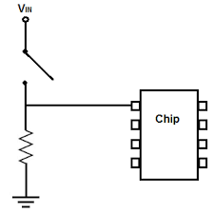
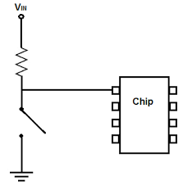
Pull-up & Pull-down
Why to do pull-up or pull-down?
Avoiding tri state ( High-Z)
Pull-down
Pull-up
There are 20K pull-up resistors built into the Atmega chip that can be accessed from software.
No internal pull-down resistor!!!
pinMode(pin, INPUT); // set pin to input
digitalWrite(pin, HIGH); // turn on pullup resistors
OR
pinMode(pin, INPUT_PULLUP)
Important application : Open drain protocols!!!!

Slide 8
Common types of sensors (based on output signal)
Variable resistance ( Analog output).
Variable capacitance.
Variable inductance.
Digital output signal
Variable duty cycle pulse.
ADC
Input capture , Interrupt , polling

Slide 9
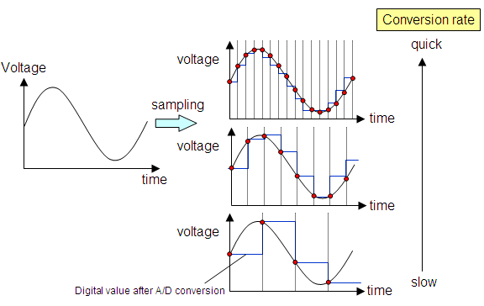
ADC
Input 0v : returns 0
10 Bit resolution
Input 2.5v : returns 512
Returns 0 – 1023
Assume reference voltage = 5v
Input 5v : returns 1023
Different ADC algorithms
In Arduino : successive approximation algorithm
DAC : using voltage divider
Simple ADC : DAC + Binary search

Slide 10
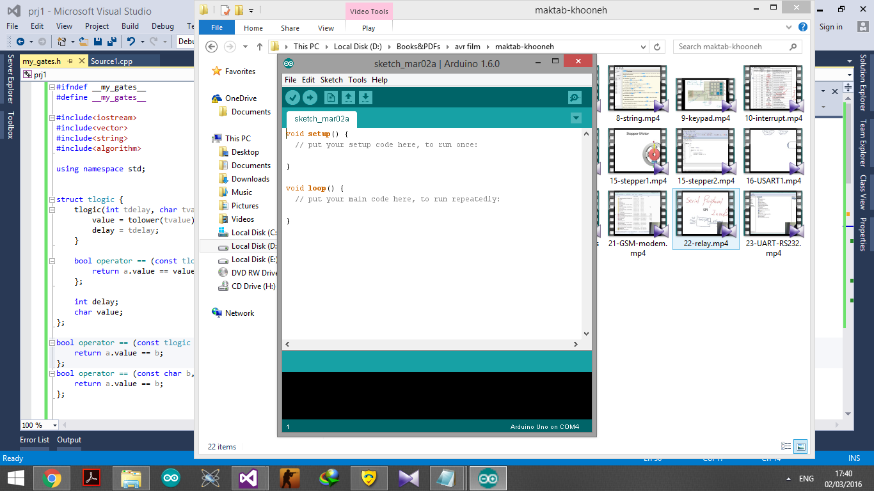
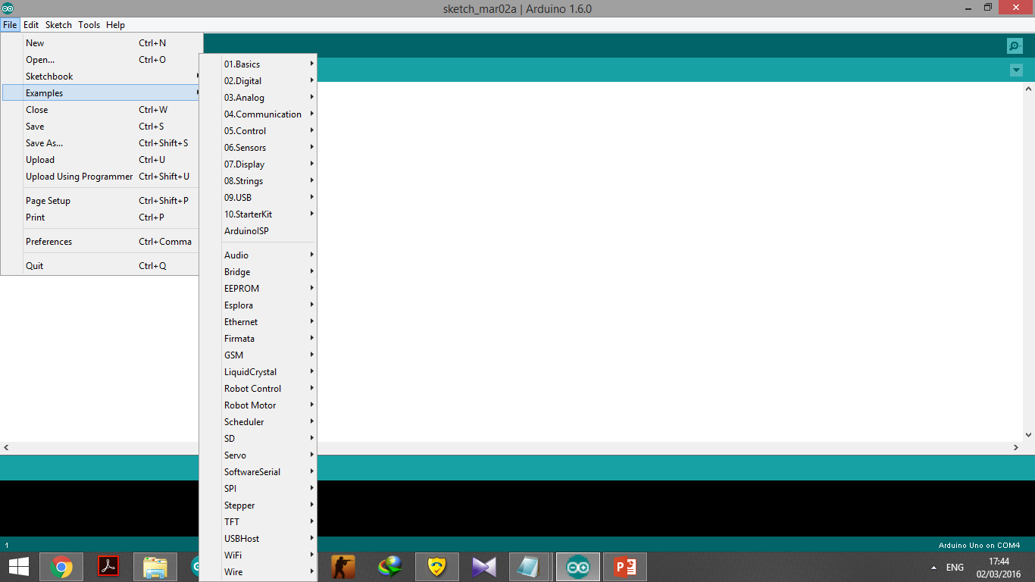
IDE & Examples
Don’t forget to install Arduino driver ! (Device Manager)

Slide 11
Blinking LED
void setup() {
pinMode(13, OUTPUT); // initialize digital pin 13 as an output.
}
void loop() {
digitalWrite(13, HIGH); // turn the LED on (HIGH is the voltage level)
delay(1000); // wait for a second
digitalWrite(13, LOW); // turn the LED off by making the voltage LOW
delay(1000); // wait for a second
}
pinMode()
digitalWrite()
digitalRead()
analogWrite()
analogRead()
delay()

Slide 12
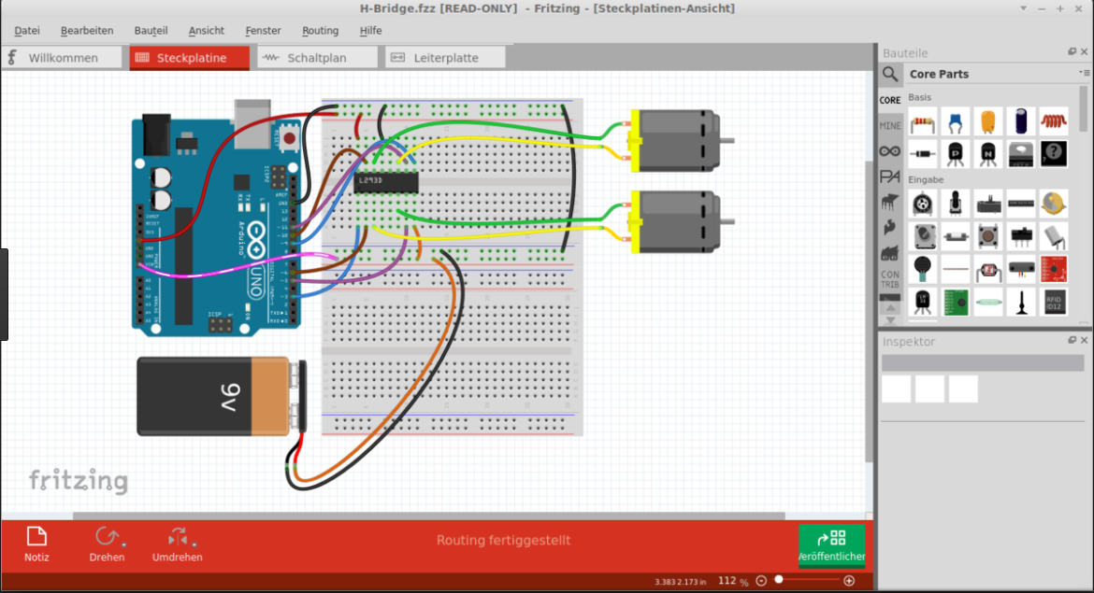
Fritzing
1. Open-source software.
2. Document prototype.
3. Manufacture professional PCBs.
It has Arduino and Breadboard !

